Slide 1

Final Project EFFICIENCY ANALYSIS OF WELLS IN GULFCOAST COUNTY USING DEA
Group Member:
Md Saffiquzzaman Chowdhury (L20567403)
Deseyi John (L20578544)
Jigarbhai Sonani (L20578048)
Minhajul Abedin Tajik (L20521113)
MAY 8, 2023
CVEN 5301: OPTIMIZATION FOR ENGINEERS
Dr. E. Annette Hernandez, PhD, PE

Slide 2
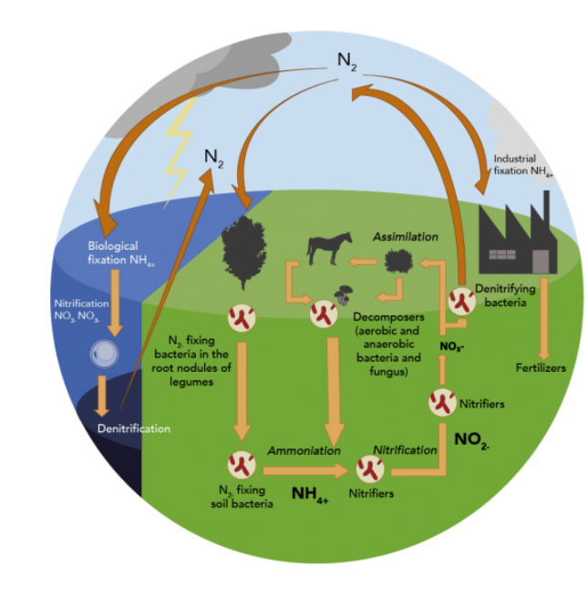
Introduction
Motivation: Nitrate is naturally occurring in groundwater and is essential for plant growth. Excessive levels can be harmful to human health and can come from agricultural practices, leaky septic systems, and other human activities. To prevent contamination, it is important to monitor nitrate levels and use responsible chemical practices and proper septic system maintenance. Overuse or improper application of fertilizers is a major contributor to excess nitrate leaching into groundwater.

Slide 3
Objective
Use DEA to measure the efficiency of wells in Gulf coast County.
Identify the most and least efficient wells based on the DEA analysis.
Factors Affecting Nitrate Level in Ground Water:
Animal manure and wastewater
Septic systems
Land-use changes
Industrial activities
Natural sources

Slide 4
Effect of excess nitrate
The permissible limit for nitrate in drinking water varies depending on the country and the organization setting the standards. In the United States, the Environmental Protection Agency (EPA) has set a maximum contaminant level (MCL) of 10 milligrams per liter (mg/L) for nitrate-nitrogen in drinking water.
This standard is based on the potential health effects of nitrate ingestion, particularly in infants' and young children who are more susceptible to a condition known as methemoglobinemia or "blue baby syndrome“ and weakness, excess heart rate, fatigue, and dizziness.

Slide 5
Methodology
The first step is to download metadata from https://www.twdb.texas.gov/ which contains information on soil properties, hydrologic characteristics, and topography.
Data filtering is necessary to ensure that only relevant data is included in the analysis.
Once the data has been filtered and imported into the DEA R-model, the efficiency of each well can be evaluated.
The results of this analysis can be used to identify the most efficient well for nitrate and inform decision-making around management and mitigation strategies.
The effectiveness of nitrate removal depends on many factors, including the specific well design and location, as well as external factors such as climate and land use.
Therefore, it is important to approach this issue with a comprehensive and holistic perspective, using a range of tools and strategies to address the root causes of nitrate contamination in groundwater.

Slide 6
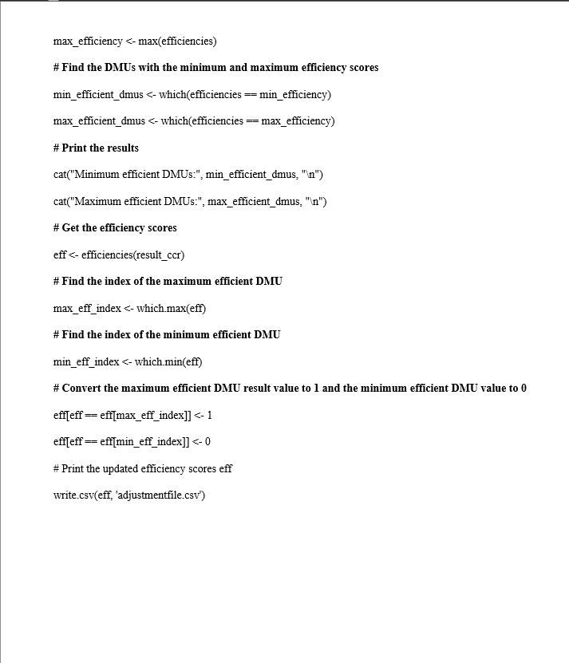
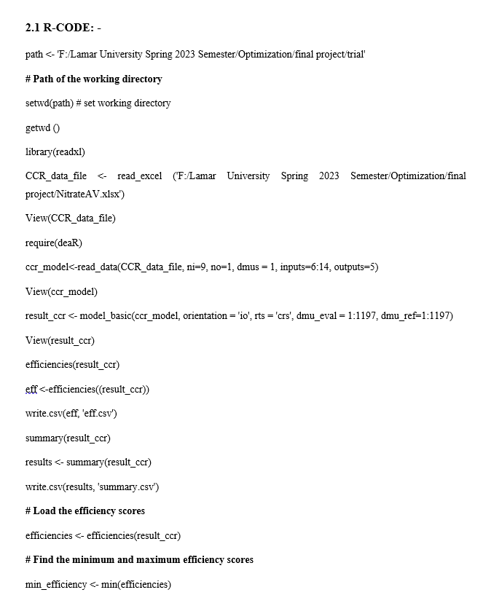
R-code for DEA

Slide 7
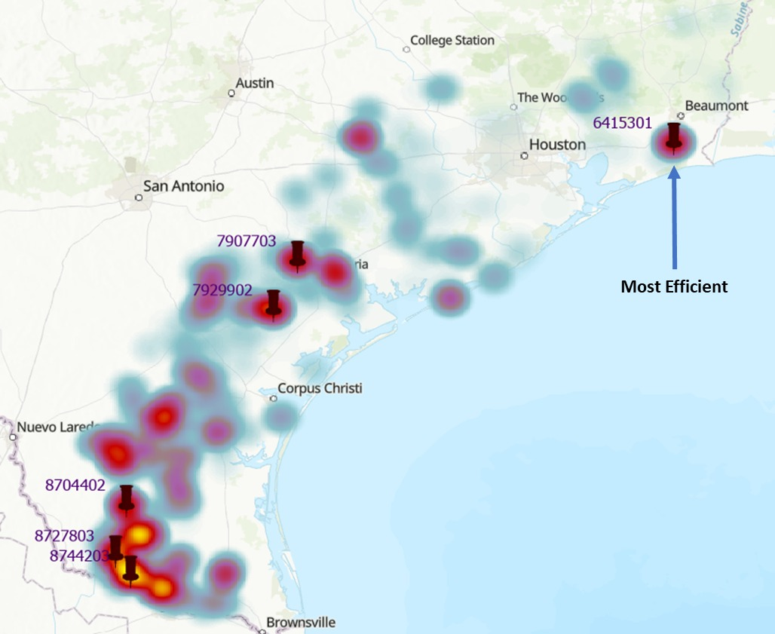
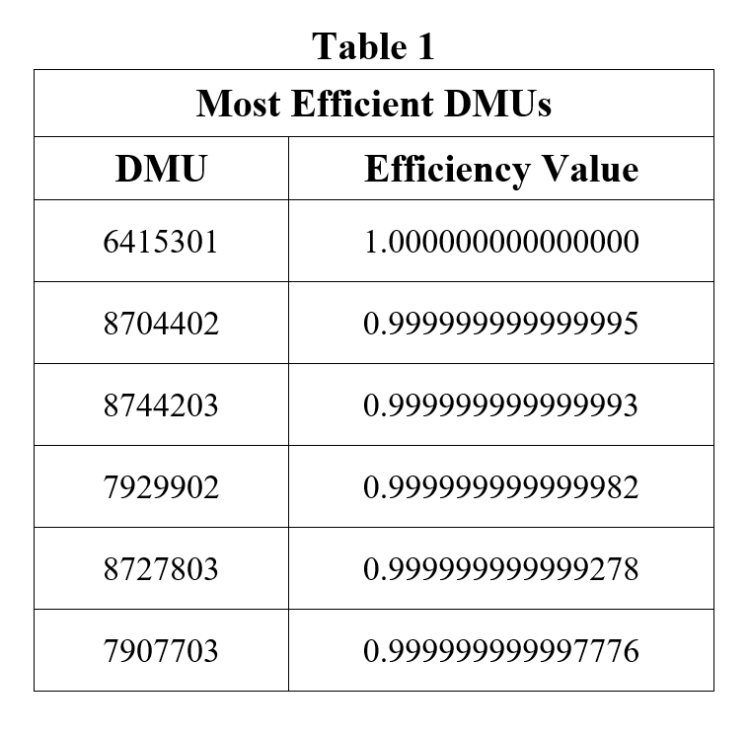
Result

Slide 8
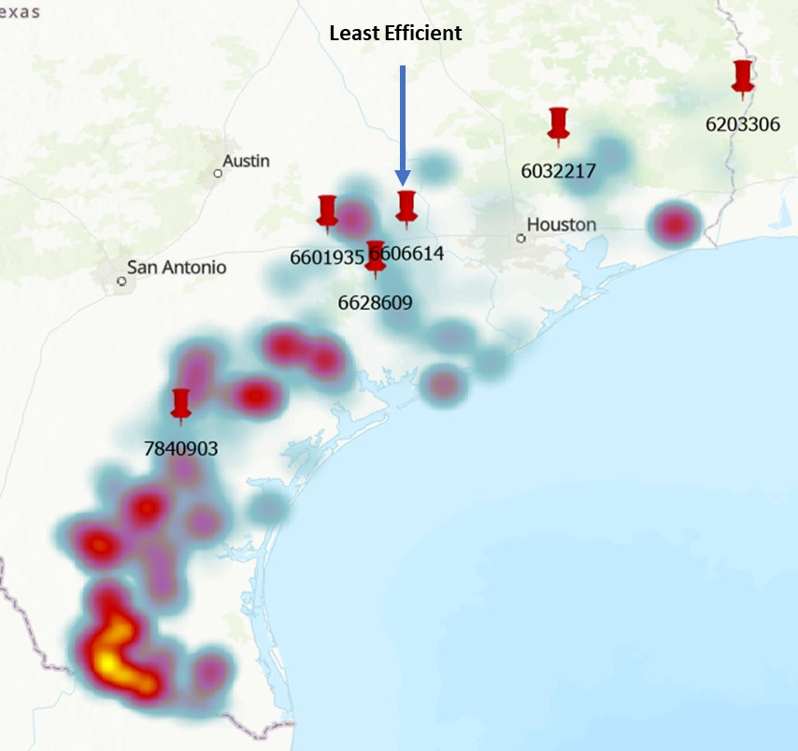
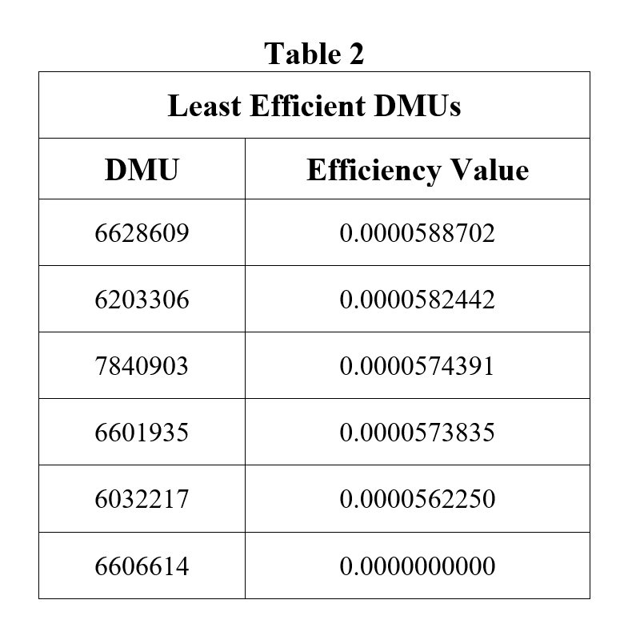
Result

Slide 9
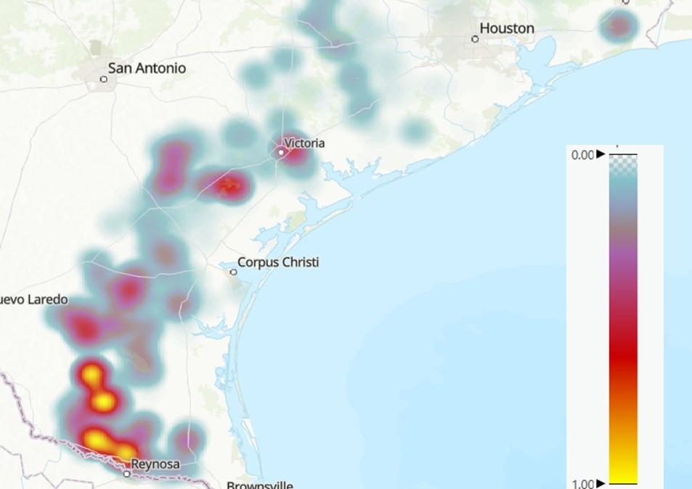
Efficiency of wells

Slide 10
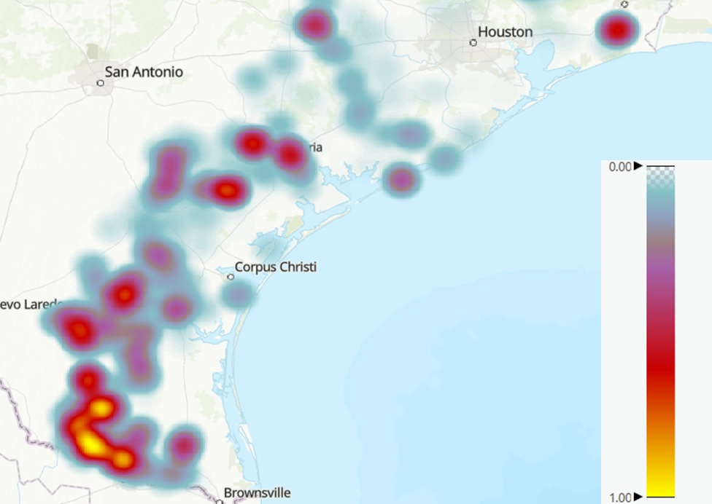
Heat Map with Avg nitrate

Slide 11
Discussion
Reduce Nitrogen Use
Proper Wastewater Management
Precision Farming
Crop Rotation
Treatment Systems
Education and Outreach

Slide 12

Thank you

